Slide 1
Multipath IP Transmission: Motivation, Design and Performance
Guibin Tian and Yong Liu
ECE Dept.
NYU. Tandon School of Engineering

Slide 2
Outline
Background and Motivation
Multipath TCP vs Multipath IP
Design of Multipath IP
Experiments
Conclusion

Slide 3
Background && Motivation
Most devices have multiple interfaces
Multiple NICs, 4G interface
Seamless handover among networks
walk out of wifi, switch to 4g and vice versa
Better tolerance of connection errors
hot-standby connections
Higher throughput when available
4G and WiFi work together, Datacenter network

Slide 4
Multipath TCP
MPTCP has been well implemented
Single TCP connection, multiple sub-flows
Can only be used for TCP
Still large percentage of UDP traffic
UDP traffic may increase given loss event is rare
Applications with low delay requirement prefer UDP
Not eligible for application specific optimization
Sub-flows are regular TCP connections
Built-in character of packets assignment is best effort
High throughput vs Low delay, how to balance?

Slide 5
Implement Multipath at IP layer
Almost all traffic can benefit from MPIP
TCP, UDP
Low overhead comparing to MPTCP
No subflow maintenance
Easy to implement comparing to MPTCP
IP layer is simple
Different configuration for different applications
MPIP manages path in a more customized way
High throughput vs Low delay requirement
Smart decision based on application objectives

Slide 6
High-Level Architecture
Application
socket
Application
Transport
Transport
Multipath IP
Network
Path₁
Path₂
Path_{n}
Datalink
...
Physical

Slide 7
IP Layer Control Communication
No Feedback in IP as in TCP, needs one!
Insert CM block to Packet as carrier
Attach CM at the end of packets
Fields in the control message
Node ID, Session ID, Path ID, Packet Timestamp,Feedback Path ID, Path Delay, IP List, Flags, Checksum
Ethernet Header
IP Header
TCP/UDP Header
User Data
Control
Message
Tail

Slide 8
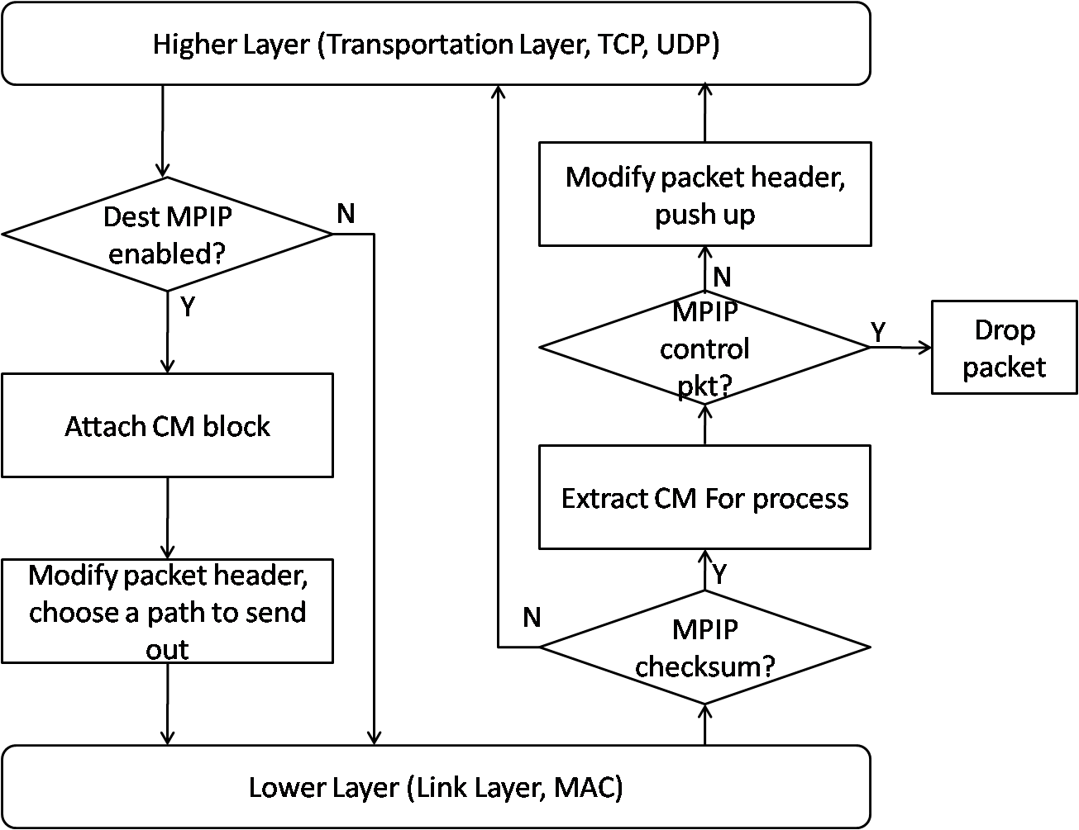
Workflow of Sending/Receiving Packets

Slide 9
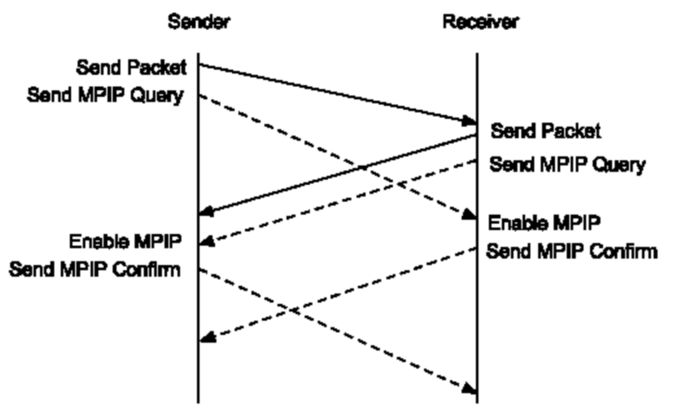
MPIP Availability Handshake
Backward compatible
to old system
MPIP_ENABLE_FLAG
MPIP_ENABLED_FLAG
IP Address | Port Number | MPIP Availability | Query Count
IP1 | P1 | True | 2
IP2 | P2 | False | 5

Slide 10
Session Management
One session remains unchanged during one connection, critical to mobility/handover.
One session is identified by one socket pair, packets from different paths have the same session in Table below if they have the same Node ID and session ID in CM
Node ID | Session ID | Source IP | Source Port | Destination IP | Destination Port | Update Time | Protocol | Next Seq No
ID1 | SID1 | SIP1 | SPORT1 | DIP1 | DPORT1 | T1 | TCP | S1
ID2 | SID2 | SIP1 | SPORT2 | DIP1 | DPORT2 | T2 | UDP | 0
ID2 | SID2 | SIP2 | SPORT3 | DIP2 | DPORT3 | T3 | TCP | S2
ID2 | SID2 | SIP2 | SPORT4 | DIP2 | DPORT4 | T4 | UDP | 0

Slide 11
Path Management
Given M, N interfaces at each end, there will be M*N paths,
maintained in the table below.
Each path belongs to one session
Node ID | Path ID | Source IP | Destination IP | Min Network Delay | Real-time Network Delay | Real-Time Queuing Delay | Max Queuing Delay | Path Weight | Feedback Time
ID | PID11 | SIP1 | DIP1 | D_{min11} | D11 | Q11 | Qmax11 | W11 | T11
ID | PID12 | SIP1 | DIP2 | Dmin12 | D12 | Q12 | Qmax12 | W12 | T12
ID | PID21 | SIP2 | DIP1 | Dmin21 | D21 | Q21 | Qmax21 | W21 | T21
ID | PID22 | SIP2 | DIP2 | Dmin22 | D22 | Q22 | Qmax22 | W22 | T22

Slide 12
Feedback Loop
When sending a packet, path ID and timestamp added to CM, delay is calculated after it arrives.
When sending back packets, feedback path ID, and path delay added to CM, added to path table after it arrives.
Each node maintain delay information for opposite node in Table below
Node ID | Path ID | Path Delay | Feedback Time
ID11 | PID11 | D11 | J11
ID12 | PID12 | D12 | J12
ID21 | PID21 | D21 | J21
ID22 | PID22 | D22 | J22

Slide 13
Heartbeat
TCP have bi-directional traffic (ACK)
no heartbeat needed.
Piggyback mechanism works properly
UDP traffic can be one-way
no built-in feedback
Use MPIP_HB_FLAGS message. When feedback time expires for some time, send MPIP_HB_FLAGS message back for feedback

Slide 14
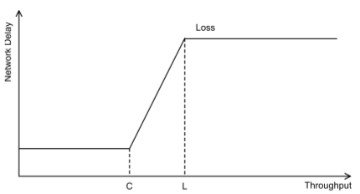
Path Selection—Delay based Solution
Loss event is rare, delay-based is for high bandwidth-delay
connection.
“FAST TCP: Motivation, Architecture, Algorithms, Performance”, Wei, D.X, Cheng Jin, Low, S.H, and Hegde, S in Networking, IEEE/ACM Transaction, 2006.
Before C, no queue, propagation delay
Between C and L, queue accumulates, queuing delay increase
After L, Loss, maximum queuing delay

Slide 15

Path Selection—Delay based Solution
Given delay information in Path Table, define path weight
for traffic
Every Path has the same W value when constructed(1000)
Queuing delay as the metric for throughput
For path whose queuing delay larger than average value, decreases W by 10, vice versa

Slide 16
Path Selection--Customized Routing
Provide length-based routing customization(User define)
IP Addr | Port Number | Protocol | Start Len | End Len | Priority
* | 23 | 6 | * | * | 0
192.168.1.2 | 80 | 6 | 200 | * | 1
Priority:
0: Responsive consideration, delay sensitive, small pkts (ack, audio). Path with smallest delay will be chosen.
1: Throughput consideration, queuing delay sensitive, large pkts (File download). Delay based algorithm will be used.

Slide 17
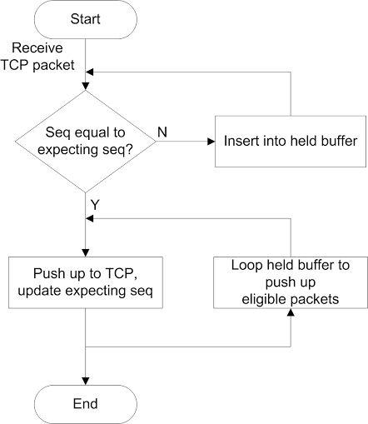
Dealing with out-of-order TCP packets
Different delay among paths results in out-of-order, furtherly trigger congestion control, and reduction of sending window.
Buffer out-of-order packets, wait for correct packet to arrive, then push up together
Maximum buffer size in case of loss(10)

Slide 18
Dealing with NAT limitation
Limit
Most NAT devices drop TCP packets without related TCP connections.
Solution
psudo TCP connection
Implement three-way handshake at IP layer
UDP wrapper
Wrap TCP packets on non-original paths with UDP,
unwrap it when arriving
Unknown Limitations
e.g., application layer gateway can modifies TCP sequence number.
MPTCP solution
Add checksum. Roll back to single path if checksum doesn’t match
MPIP solution
Monitor update time for session, switch back when expires

Slide 19
MPTCP and MPIP Together
Can exist simultaneously
MPTCP at transportation layer, MPIP at network layer
More paths at MPIP layer
Regular TCP connection for MPTCP subflows, each subflow has multiple MPIP paths
Result
Work perfectly, better than work
independently
Application
socket
Multipath TCP
TCP₁
TCP₂
TCP_{m}
...
Multipath IP
Path₁
Path₂
Path_{n}
...

Slide 20
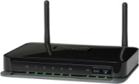
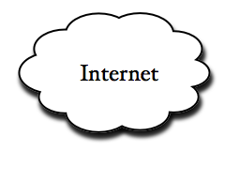
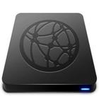



Performance Evaluation
System Implementation
Based on Linux Kernel 3.12, implement multipath IP at network layer
Merge multipath TCP and multipath IP
Labor: about 5000 lines code
No previous kernel experience and mentor in kernel development
Experiment Testbed
Two desktops with two NICs of 100Mbps (Capacity: 200Mbps)
Multipath IP enabled ubuntu installed
Customized iperf used for TCP experiments
Skype used for UDP and customization routing.
Internet experimen through Optimum, FIOS, and 4G
Client
(NYC)
Server
(Utah)

Slide 21
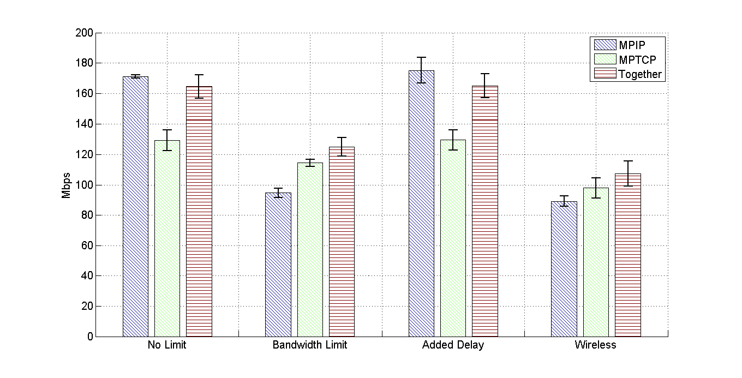
TCP Throughput Comparison
Bandwidth Limit: 20Mbps, 20Mbps limitation
Add Delay: 10ms each

Slide 22
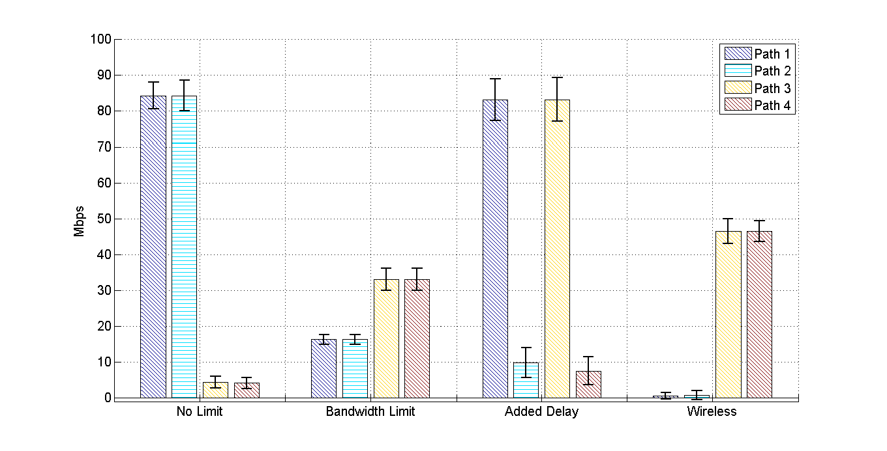
Multipath IP packet assignment
Path Coupling causes inequal assignment

Slide 23
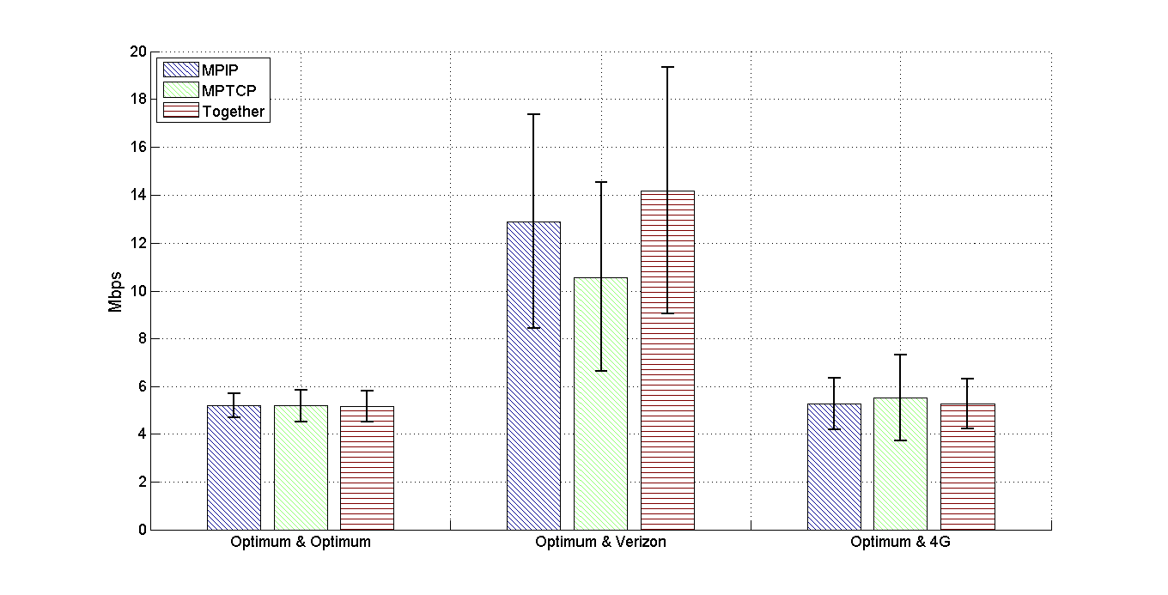
Internet TCP
Optimum Capacity: About 5.2Mbps
FIOS Capacity: About 10Mbps
4G Capacity: About 900Kbps

Slide 24
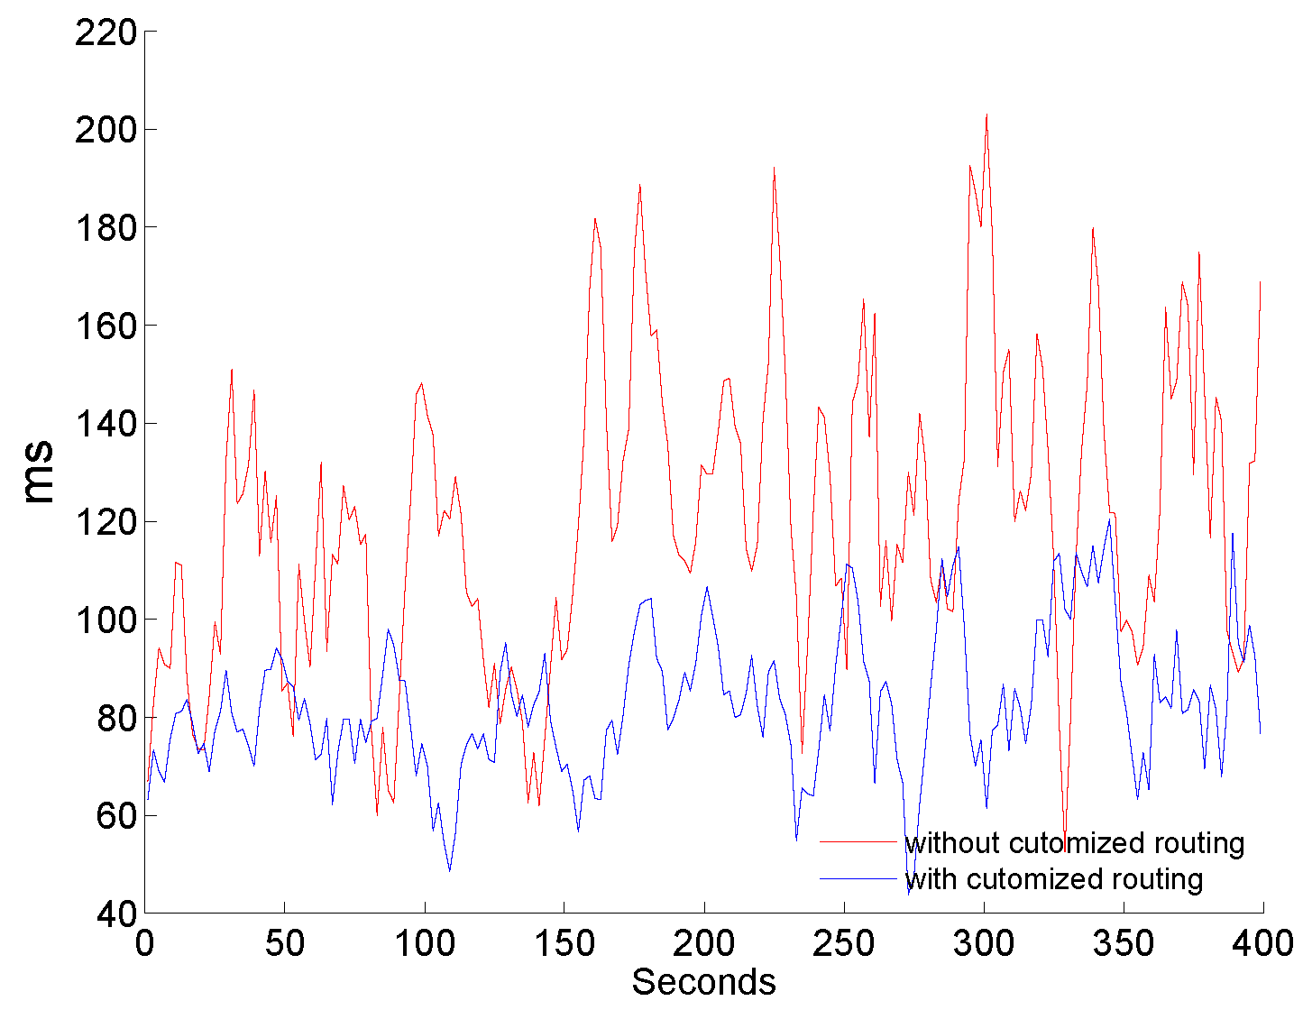
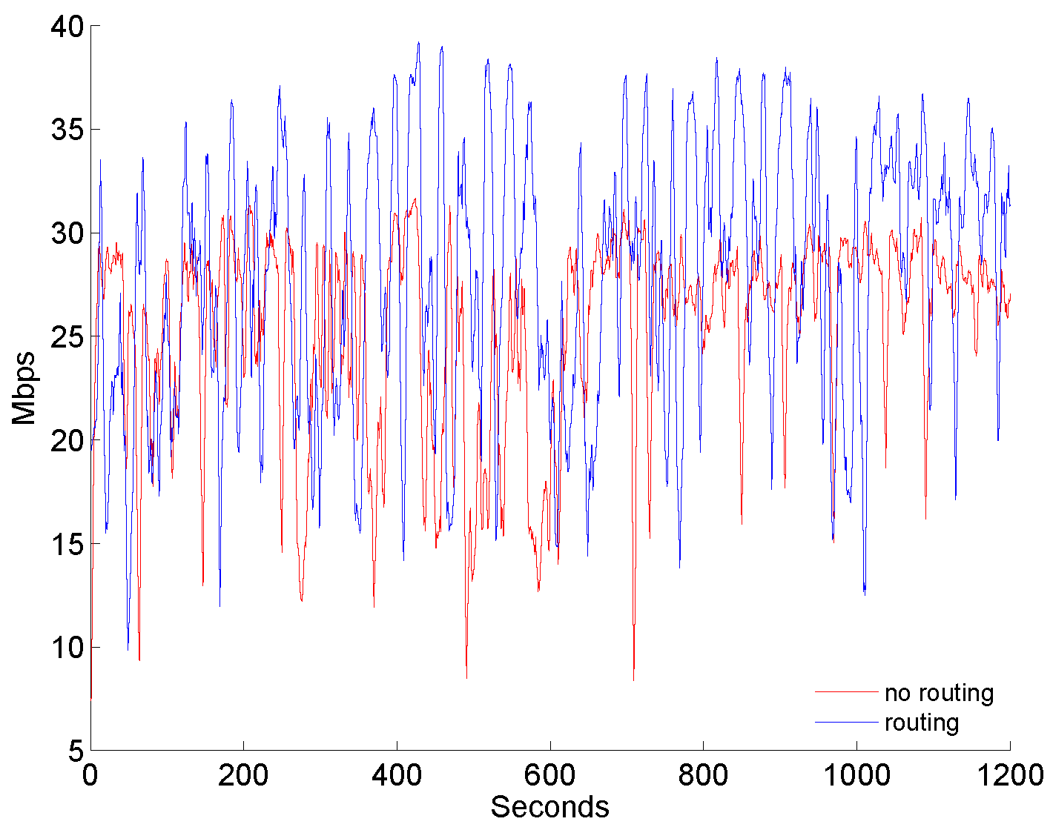
UDP and Customized Routing
Skype Delay
TCP ACK optimization
High BW High Delay
vs
Low BW Low Delay
Same fixed path weight to generate out-of-order packets(wireless vs wired)

Slide 25
Conclusion & Future Work
Implement Multipath at IP level
Multipath gain for both TCP and UDP
Seamless/Transparent connection switch
Customized IP routing
Can be integrated with MPTCP
Future Work
A better IP routing system
A better path selection algorithm
Mobile Implementation

